Slide 1
Genome Annotation
“from sequence to biology”
Melody Lindsay
2024 Bioinformatics of Microbial Single Cells Workshop

Slide 2
Annotation
The process of identifying and associating function to various segments of the assembled DNA sequence. It consists of 3 main stages:
Gene prediction
Gene identification (protein coding, ribosomal RNA genes, transfer RNA genes)
Identification of other genomic elements (such as: promoters, enhancers, transcription factor binding sites)
Some commonly used annotation pipelines include Prokka (Seeman, 2014) and DRAM (Shaffer et al., 2020)
And now: GORG Classifier! Incorporates annotations of database SAGs!
But there are so many: general, specific, depends on what your question is.
Question: What do you look for in annotations?

Slide 3
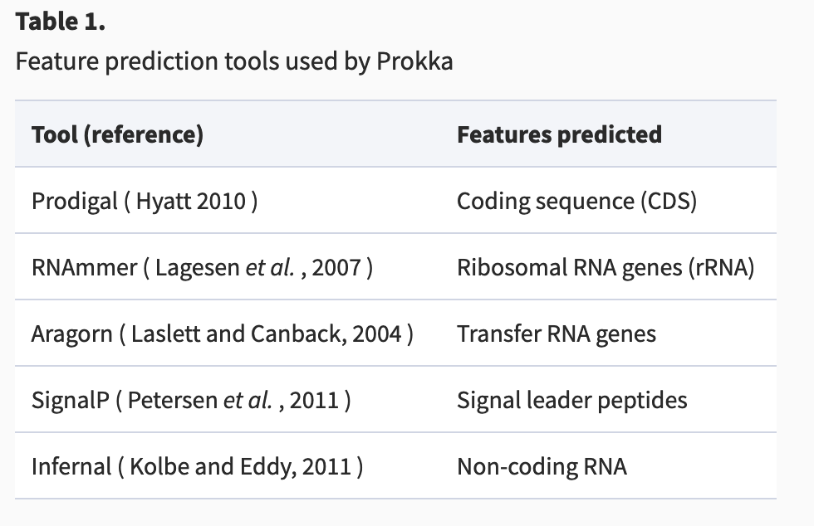
Prokka
First command line software tool to fully annotate bacterial, archaeal, and viral genomes
Relies on external feature prediction tools to ID the coordinates of genomic features within contigs

Slide 4
Prokka
For the protein coding genes, the function is inferred by comparison to databases of known proteins in a hierarchical matter.
Briefly, prokka first searches, using BLAST+, three (small but well curated) databases, ISfinder, NCBI Bacterial Antimicrobial Resistance Reference Gene Database, UniProtKB (SwissProt).
Then HMMER3 is used for similarity searching against protein family profiles (mostly bacterial specific).

Slide 5
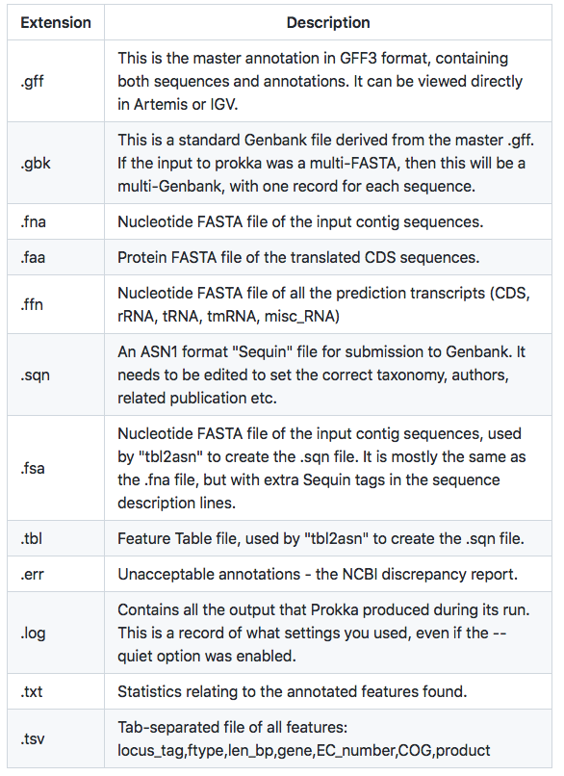
Prokka
SCGC deliverable – let’s see what this file looks like
/storage/data/sag-data/gorg-dark/v1_deliverables/

Slide 6
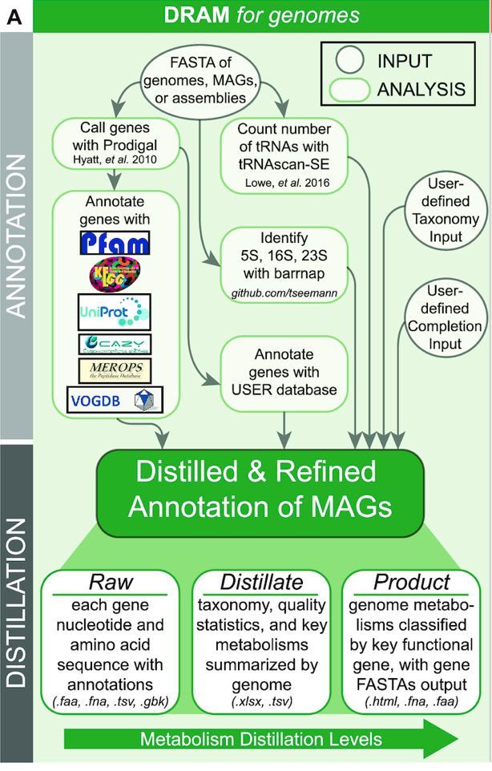
DRAM
DRAM has been recently developed for the annotation of genomes and viral contigs. Besides the identification of individual genes, DRAM attempts to put information into context: to assign them to metabolic pathways.
Predicted amino acid sequences are searched with: KEGG, Pfam, UniRef90 and MEROPS using MMseqs2.
Additionally, HHMER3 is used for HMM profile searches of dbCAN and VOGDB.
Shaffer et al., 2020

Slide 7
DRAM
Shaffer et al., 2020
Notes:
B) Flow chart shows the metabolisms from DRAM’s Distillate. Distillate provides five major categories of metabolism: energy, transporters, miscellaneous (MISC), carbon utilization and organic nitrogen. Each major category contains subcategories, with outlines denoting location of information within Distillate and Product. (C) Heatmap shows presence (colored) and absence (white) of databases used in comparable annotators to DRAM. Annotators are colored consistently in A–E, with Prokka (30) in black, DFAST (31) in light gray, MetaErg (32) in dark gray and DRAM in red. Barcharts in (D–F) show database size (D), as well as number of annotated (E), hypotheticals (F), and unannotated (G) genes assigned by each annotator when analyzing in silico soil community. See methods for definitions of annotated, hypothetical, and unannotated genes, relative to each annotator.

Slide 8
Running DRAM for analysis…
First, identify 1-2 SAGs of interest – you can choose based on GORG annotations, or lineage identity
Then, we will run the DRAM commands so that they can run during the lecture
-then coffee break(?)-
Analysis of outputs, how we can manipulate it at a larger scale, and a deeper dive into misannotations

Slide 9
DRAM annotation outputs
with further caveats!

Slide 10
DRAM outputs
Now:
Annotation summaries
Let’s go through the files you generated from the “annotate” and ”distill” DRAM commands
What are they, how can they be used? What will be most useful to you?
Then:
Some examples of misannotations, and ways to avoid
(not covering “missed” annotations, or proteins of unknown function)
Work on examples of DRAM output, manipulate and look through annotations

Slide 11
One example of visualization (made with DRAM in the “Distill” command) – this includes the dataset available in: mnt/storage/lessons/day3_metabolic_lesson/

Slide 12
Notes:
For example – what is happening with 388-A17?

Slide 13
KEGG Visualization
https://www.genome.jp/kaas-bin/kaas_main?prog=GHOSTX&way=s

Slide 14
Misannotations, or genes involved in multiple pathways (ascribed to other functions)
Rampant in databases, particularly as larger and larger sequence datasets are deposited using automated annotation programs, or as databases include contamination
How would misannotations become “the norm” for some genes?
Do you know of any common misannotations in data from organisms you work with/might work with in the future?
Common genes?
Some manual curation may be needed in some datasets
Notes:
Databases carry chimeric proteins, proteins may have been misannotated previously in function or taxonomy, you are hitting something that has a wrong entry
Lots of databases are publically available, but they are not curated!!

Slide 15
Notice anything suspicious?
How would you go about verifying? (check which file??)

Slide 16
Check databases (KEGG)
KEGG database
Notes:
OTHER MISANNOTATIONS:
Gene involved in nitrogen assimilation – flagged as dissimilatory nitrate to ammonium
Carbon fixation – TCA cycle, ATP citrate lyase involved in carbon fixation (appear to be TCA cycle, unless you blast with another ATP citrate lyase)
Bring up other data sets – the ocean is relatively well studied!
Tendency for misannotations is even higher
Arsenic reduction misannotation? – one of the genes that is a regulation factor (in multiple pathways)

Slide 17
Other ways to check for potential misannotations? Or divergence?
Active sites for enzymes (do they possess key motifs)?
Example: cytochromes
Example: hydrogenases
Specific databases of your choice
Examples: hydrogenases/HydDB, cytochrome P450 database, CAZY
Do you have any commonly misannotated genes that you know of? Common in environments/samples/microbes that you study?

Slide 18
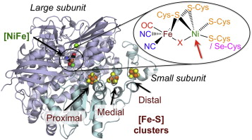
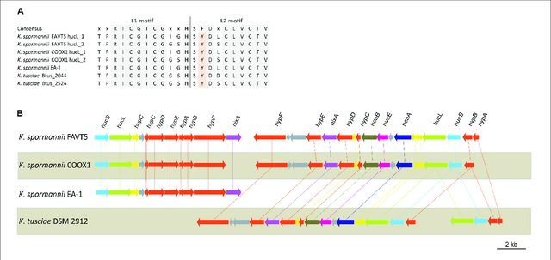
Shafaat et al., 2013
Hogendoorn et al., 2020
Example: Cysteine residues key for binding site of hydrogenases (for [NiFe]-hydrogenases, need paired CxxC motifs)
Notes:
This goes back to hidden markov models with inferring function from position sensitive models
Domains which blast may not be able to handle, due to large sequence differences. However, the modeled protein may exhibit the same functionality, only detectable through these models

Slide 19
Other Misannotations?
Carbon fixation – TCA cycle, ATP citrate lyase involved in carbon fixation (appear to be TCA cycle, unless you compare with another ATP citrate lyase). Challenge: how would you do this?
Arsenic reduction misannotation – one of the genes that is a regulation factor (actually in multiple pathways, need to verify that other genes are present in the arsenic reduction pathway!). Challenge: how would you do this?
Notes:
OTHER MISANNOTATIONS:
Gene involved in nitrogen assimilation – flagged as dissimilatory nitrate to ammonium
Carbon fixation – TCA cycle, ATP citrate lyase involved in carbon fixation (appear to be TCA cycle, unless you blast with another ATP citrate lyase)
Bring up other data sets – the ocean is relatively well studied!
Tendency for misannotations is even higher
Arsenic reduction misannotation? – one of the genes that is a regulation factor (in multiple pathways)

Slide 20
Other ways to check for potential misannotations? Or divergence?
Lindsay et al., in prep

Slide 21
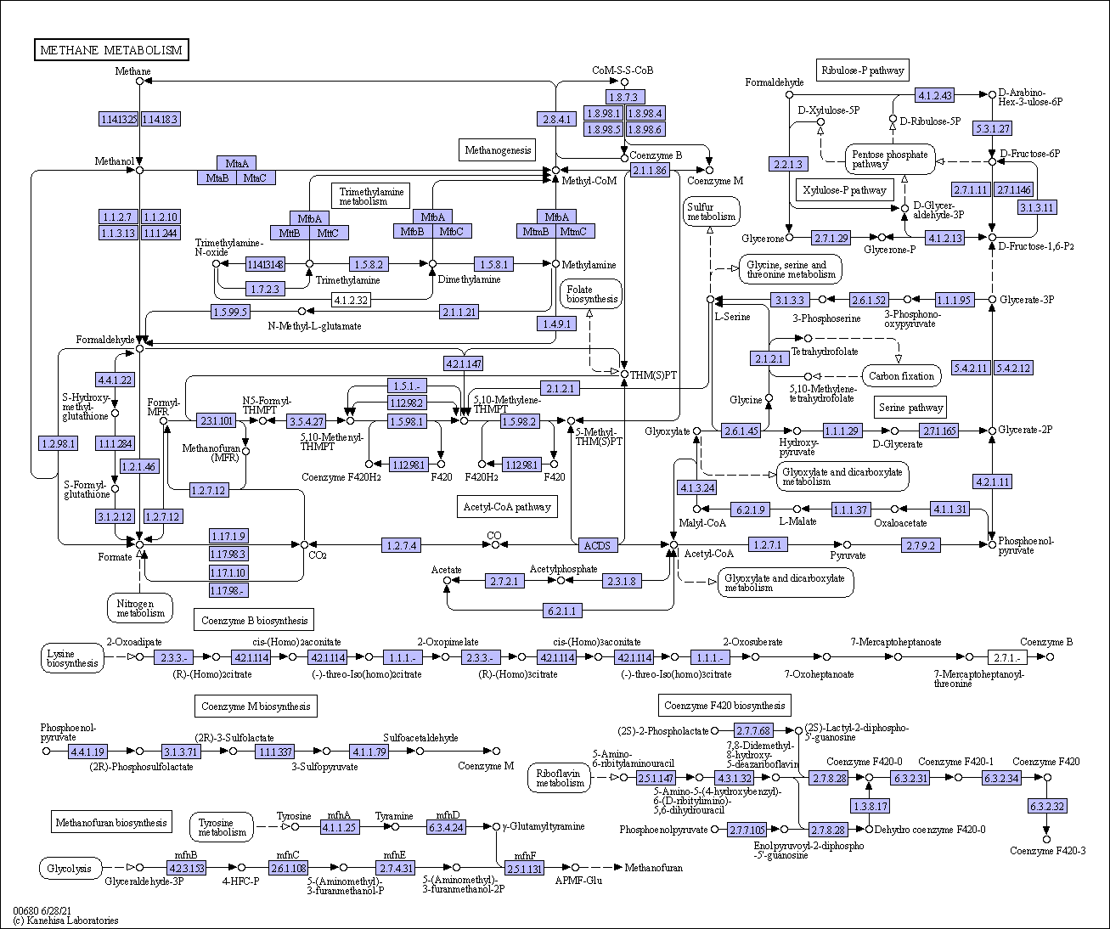
mcrB tree
Distillate output
Complete pathways?
(sequences gleaned from Raw output)
Genome.jp
Notes:
As you saw earlier, a lot of annotations of pathways are manually curated, and put together to tell a story about a microbes whole metabolism
Each piece is checked, verified, and even then you may need to look closely at genes that are tagged “unknown function”

Slide 22
Shaffer et al., 2020

Slide 23
What other metabolism summaries are you interested in? Try this command with your broad category of choice (as seen in product.html)
As a reminder - you will need to parse out the excel file sheets again, in case you want to look at different broad categories (other than energy)!
Other exploratory ideas:
How complete are individual pathways in this dataset? (as annotated by the DRAM pipeline?)
1) how complete are cytochrome bc complexes from your SAGs of choice? (where can you find this data?)
2) how complete are key carbon cycling pathways?
We also have SAG data under /storage/lesson_analyses/annotations/. Can you use the annotate and distill commands (from DRAM) to make summary annotations.tsv, product.html & .tsv, metabolism.xlsx, of your choice of taxa?
Keep in mind that DRAM also works with MAGs and other data types.

Slide 24
Guided questions for exploration:
What metabolic capabilities are present in cells belonging to the most abundant genus in GORG-Dark?
Are any cells capable of {insert interesting metabolism here}?
What might be a good first step in locating a metabolism of interest?
If you have a cell capable of carbon fixation, how complete is the pathway? Are ‘key genes’ present?

